Slide 1

PRESENTATION ON PROJECT DATA INVENTORY SYSTEM from ITE INFOTECH Pvt. Ltd.
University Institute Of Technology RGPV, Bhopal(M.P.)
Presented By: ANAND GUPTA
Enroll. : 0101CA201005
MCA 4th Semester

Slide 2
Objective And Purpose
To ensure a continuous supply of materials and stock so that production should not suffer at the time of customers demand.
To avoid both overstocking and under-stocking of inventory.
To maintain the availability of materials whenever and wherever required in enough quantity.
To maintain minimum working capital as required for operational and sales activities.
To optimize various costs indulged with inventories like purchase cost, carrying a cost, storage cost, etc.

Slide 3
SYSTEM REQUIREMENTS
CSS
PHP
SQL
Operating System Windows 11 and above
Web browser (Chrome, I.E 8 and above, Firefox, etc.)

Slide 4
TECHNOLOGY USED
FRONTEND
CSS
PHP
BACKEND
PHP
SQL

Slide 5
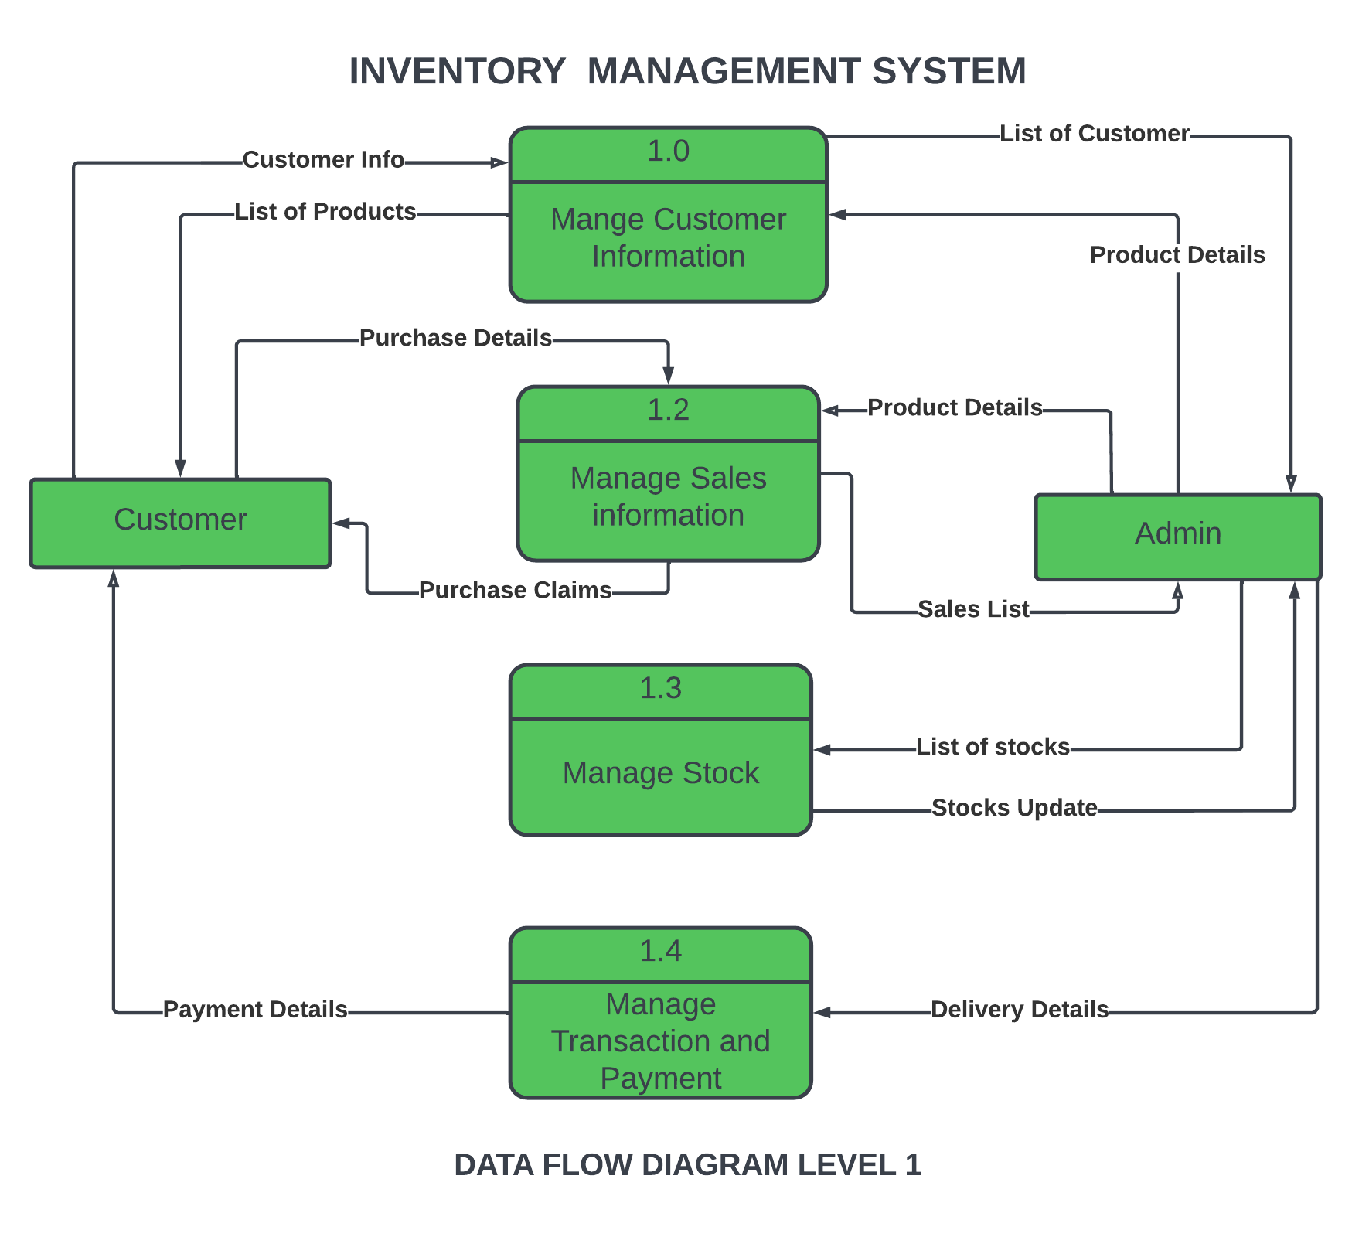
Data Flow Diagram

Slide 6
INTRODUCTION
Inventory management refers to the process of ordering, storing, using, and selling a company's inventory. This includes the management of raw materials, components, and finished products, as well as warehousing and processing of such items.
Inventory refers to all the items, goods, merchandise, and materials held by a business for selling in the market to earn a profit.
Example: If a newspaper vendor uses a vehicle to deliver newspapers to
the customers, only the newspaper will be considered inventory. The
vehicle will be treated as an asset.

Slide 7
SCREENSHOTS
User Views

Slide 8
Login Page

Slide 9
Home Page

Slide 10
Home Page

Slide 11
Service Providers

Slide 12
Service Page

Slide 13
Service Selection Page

Slide 14
LIMITATIONS
The limitations of a perpetual inventory system include a false sense of reliability and dependence on human entry. Although a perpetual system updates each time a transaction enters the system, it might lack information regarding stolen, damaged or scrapped units.

Slide 15
FUTURE ENHANCEMENT
The future of inventory is going to be flooded with updates in technology. From virtual reality, to artificial intelligence, to digital signage, and even inventory-less stores, there are constant iterations made in this industry to accelerate business and attract customers. And it's only growing from here.

Slide 16
CONCLUSION
An Inventory Management System recommends replenishment based on dynamic optimal levels, ensuring that the next order you place is the right quantity for both your customers and your business

Slide 17
THANKING YOU

